Slide 1
Python GUI
Graphical User Interface Development Using Tkinter

Slide 2
Introduction to GUI
GUI is a visual way for users to interact with a computer program.
Instead of typing commands, users can click buttons and type in text boxes.
GUI makes software easier to use and more user-friendly.
Examples of GUI Applications:
Calculator
Notepad
Login Systems
Desktop Applications
GUI improves user experience and makes applications interactive.

Slide 3
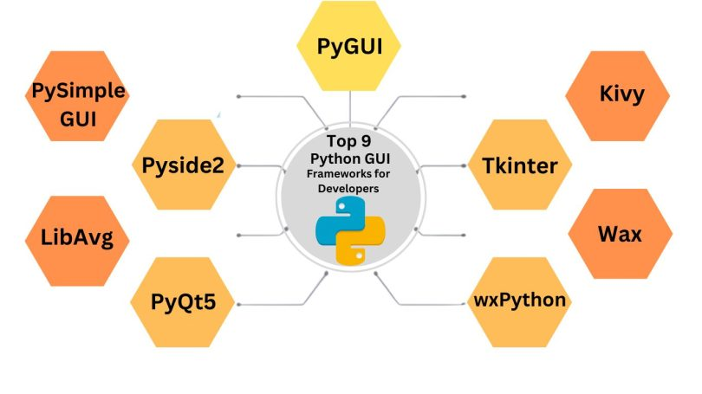
Types Of Python GUI Frameworks

Slide 4
What is Tkinter?
Tkinter is a built-in Python library used to create GUI Applications.
It allows programmers to design windows and add visual components such as buttons and labels.
Tkinter comes pre-installed with Python, so no extra installation is needed.
Features:
Easy to learn
Lightweight
Free and open source
Works on multiple operating systems

Slide 5
Why Use Tkinter?
Tkinter is popular because it is simple and suitable for beginners.
It helps students learn GUI programming without complex setup.
Advantages:
Simple syntax
Fast development
No installation required
Cross-platform support
Tkinter is widely used for educational projects and small software applications.

Slide 6
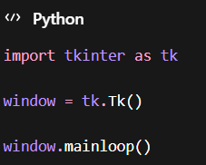
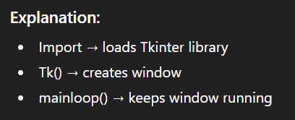
Basic Structure of Tkinter Program
Every Tkinter program follows a basic structure.
Steps:
Import Tkinter library
Create window
Add widgets
Run program

Slide 7
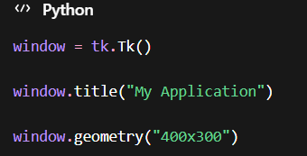
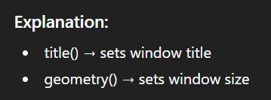
Tkinter Window
The window is the main container where all GUI components are placed.
A window can have:
Title
Size
Background color
Widgets

Slide 8
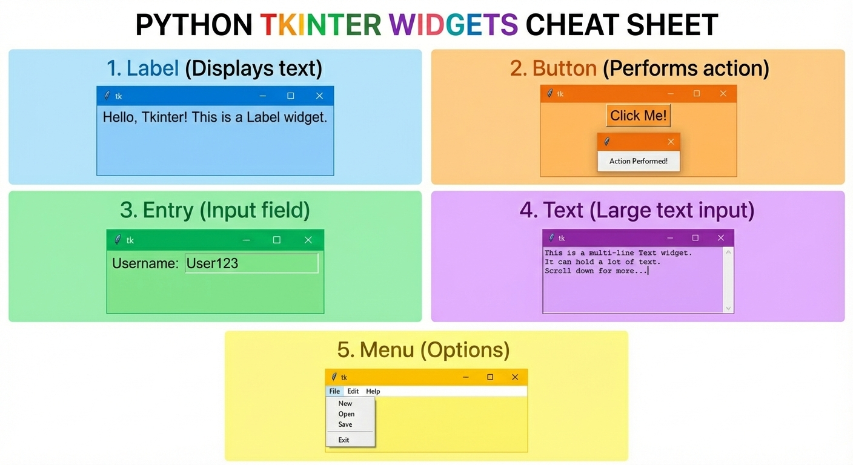
Widgets
Widgets are the basic components used to build GUI applications.
They allow users to interact with the program.
Common Widgets:
Label → Displays text
Button → Performs action
Entry → Input field
Text → Large text input
Menu → Options
Widgets make the application interactive.

Slide 9
Label Widget
A Label widget is used to display text or images on the screen.
It is mainly used for titles and instructions.
This single program contains almost all Label features:
Text
Font
Colors
Border
Size
Padding
Alignment
Multi-line text
Change text
Hide/Show
X-Y Position

Slide 10
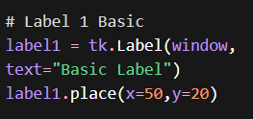
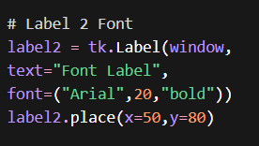
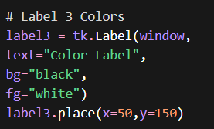
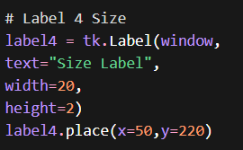
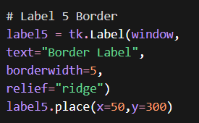
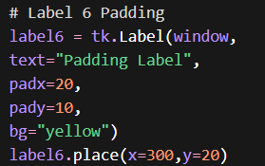

Slide 11
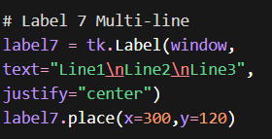
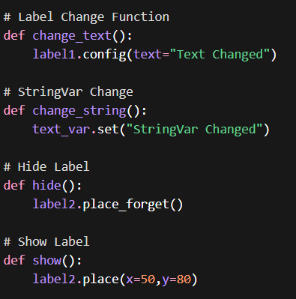
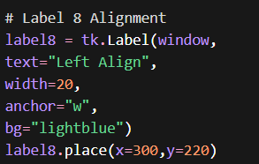

Slide 12
Button Widget
A Button widget is used to perform an action when clicked.
Buttons allow users to control the program.
Uses:
Submit forms
Login
Calculate results
Open windows
Buttons are interactive widgets.

Slide 13
Buttons
This program contains almost everything:
Text
Font
Colors
Border
Size
Padding
Disable
Enable
Change Text
Hide/Show
X-Y position
Function
Lambda

Slide 14
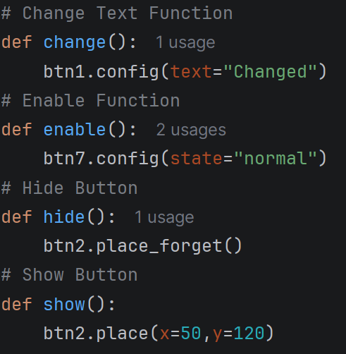
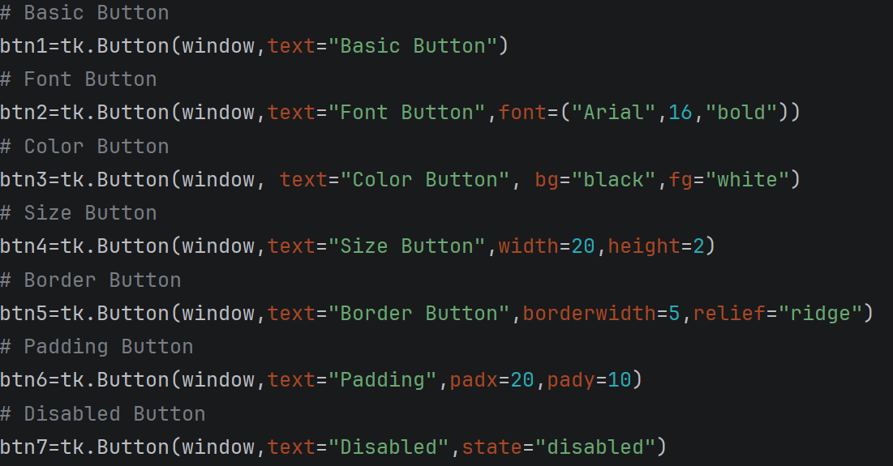
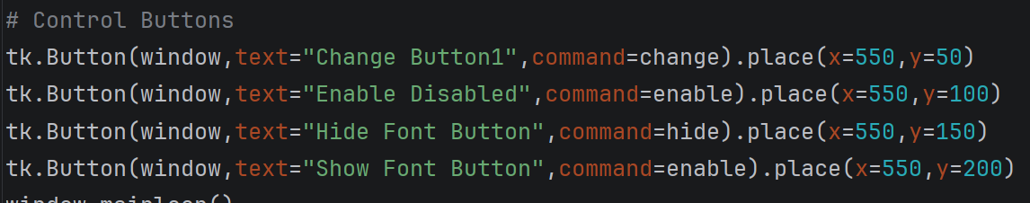
BUTTON_NAME.place(x=300,y=150)

Slide 15
Entry Widget
An Entry widget allows users to type text into the program.
It is commonly used for input.
Uses:
Username
Password
Numbers
User input
Entry widgets collect information from users.

Slide 16
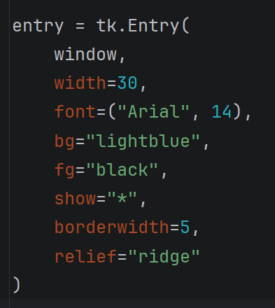
Entry Widget

Slide 17
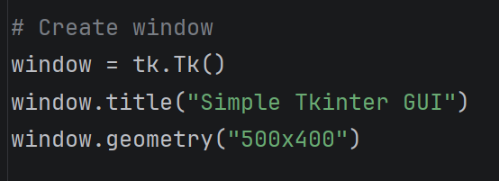
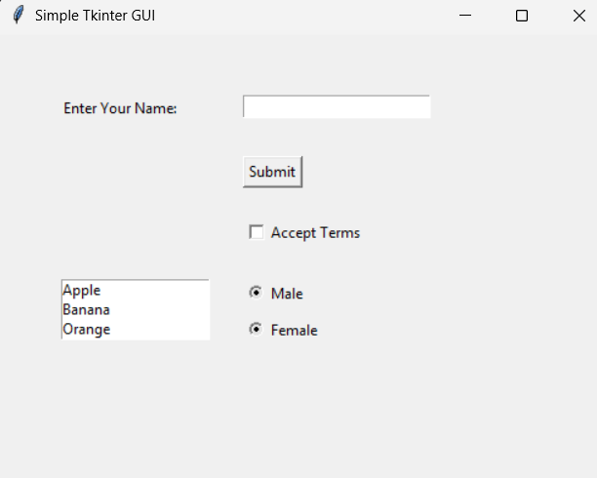
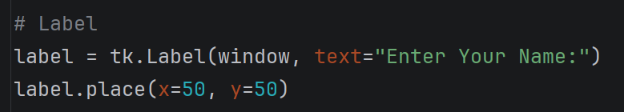
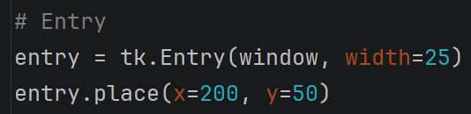
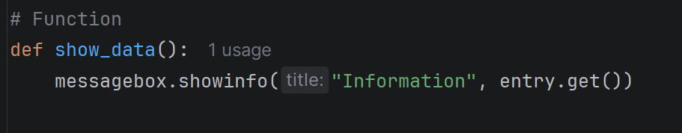
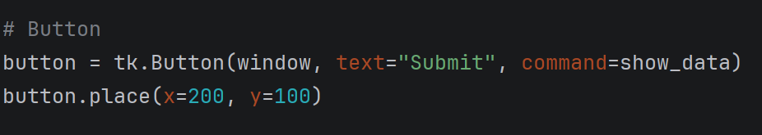
MINI PROJECT - GUI

Slide 18
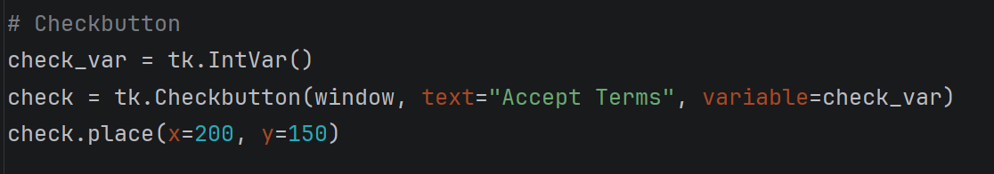
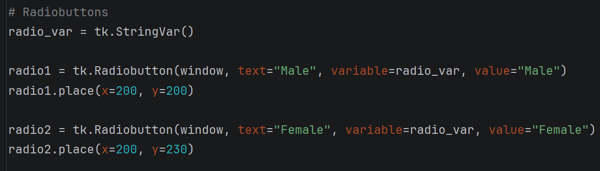
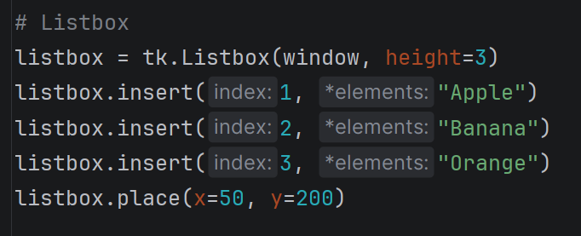
MINI PROJECT - GUI

Slide 19
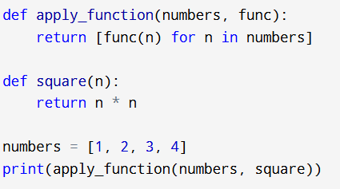
Writing a Higher-Order Function
Write a Python function that takes another function as an argument and applies it to a list of numbers.

Slide 20
What is Recursion?

Slide 21
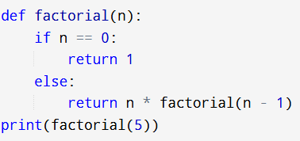
Writing a Simple Recursive Function
Write a Python function that uses recursion to calculate the factorial of a number.

Slide 22
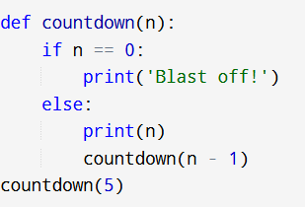
Recursive Countdown
Write a recursive function that counts down from a given number to zero

Slide 23
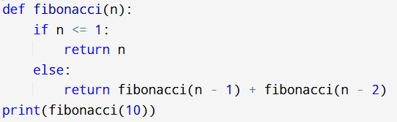
Recursive Fibonacci Sequence
Write a recursive function to calculate the nth number in the Fibonacci sequence.

Slide 24
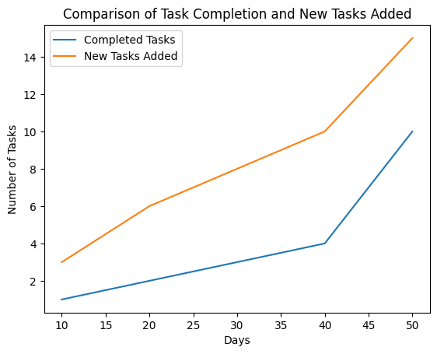
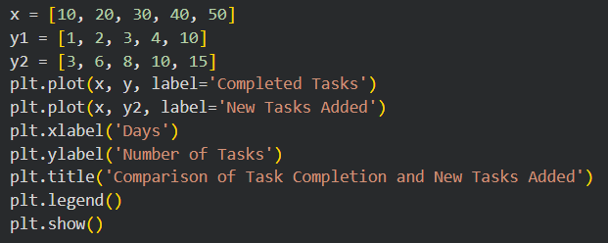
Plotting Multiple Lines
Plot multiple lines on the same chart to compare the number of tasks completed and the number of new tasks added over time.

Slide 25
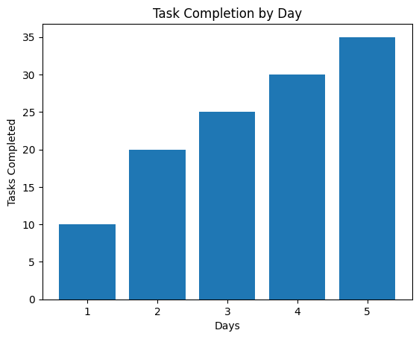
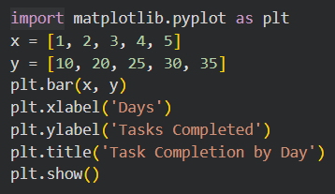
Creating a Bar Chart
Create a bar chart to represent the number of tasks completed each day.

Slide 26
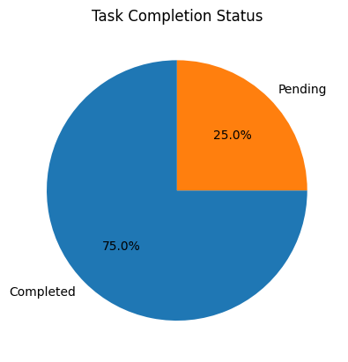
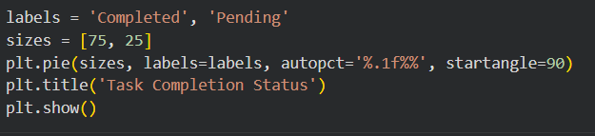
Creating a Pie Chart
Create a pie chart that shows the percentage of tasks completed versus tasks pending.

Slide 27
plt.savefig()

Slide 28
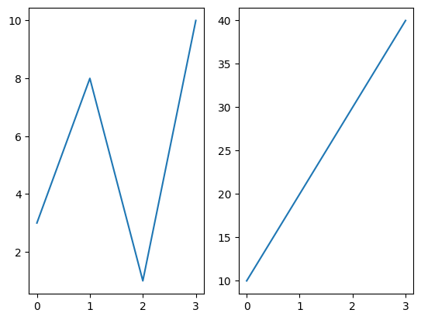
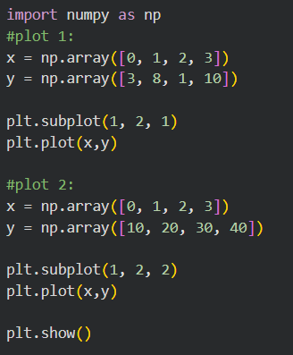
Display Multiple Plots
With the subplot() function you can draw multiple plots in one figure:

